Slide 1
Collaboration
Adult Living

Slide 2
Magic Maze Activity
The entire class has to safely reach the other side of the grid.
 | There is only one safe path and I have the master grid.
One more thing… no talking whatsoever!
 |  | Good luck!
?

Slide 3
What is COLLABORATION?
The act of working together with one or more people in order to achieve something

Slide 4
Characteristics of Collaboration
Frequent communication
Tactical information sharing
System change
Pooled, collective resources
Negotiated shared goals
Power is shared
High risk/High reward
High trust relationships

Slide 5
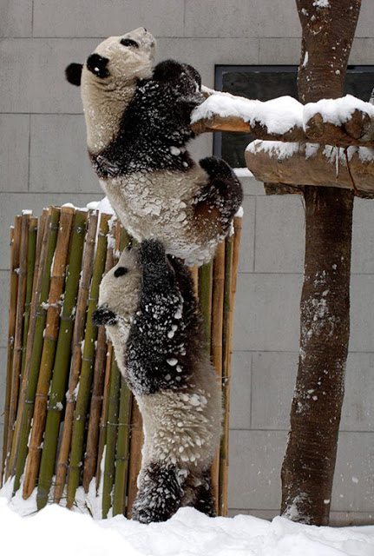
What is Good Teamwork?

Slide 6
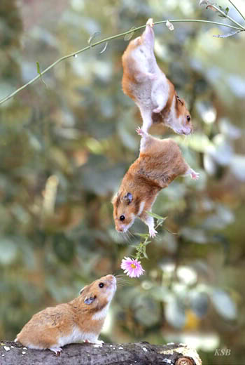
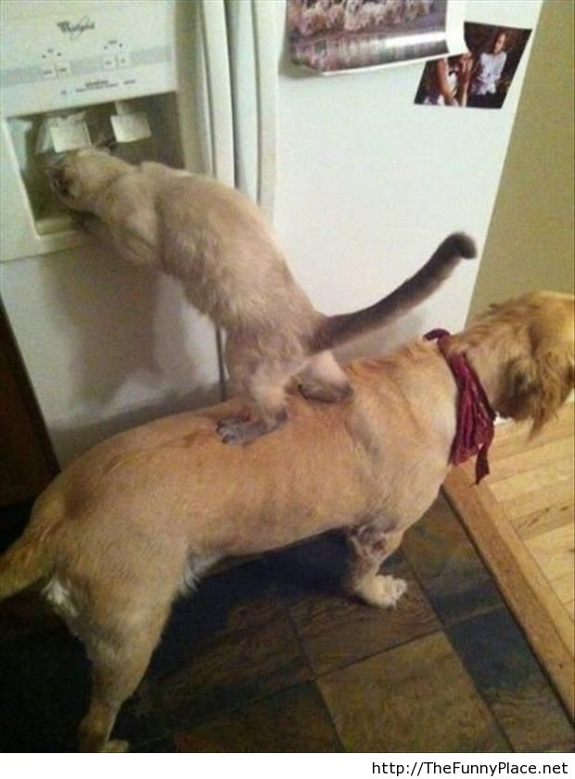
Strength in Numbers

Slide 7
Class Discussion
Describe a time when you appreciated a support system by your side to accomplish a certain task or to reach a common goal?

Slide 8
Sources
Information:
http://www.workforce.org.au/media/59204/resourcing_collaboration_what_is_collaboration_factsheet1.pdf
http://www.youtube.com/watch?v=fUXdrl9ch_Q
Images:
http://thefunnyplace.net/animals/team-work-animals/
http://s365.photobucket.com/user/bp0047/media/animals/teamwork-mice.jpg.html#/user/bp0047/media/animals/teamwork-mice.jpg.html?&_suid=139827751032000470160008759225
http://amazing-creature.blogspot.com/2011/04/teamwork.html

